Slide 1
Ship – Sailing (JavaScript Game)
Storyboard

Slide 2
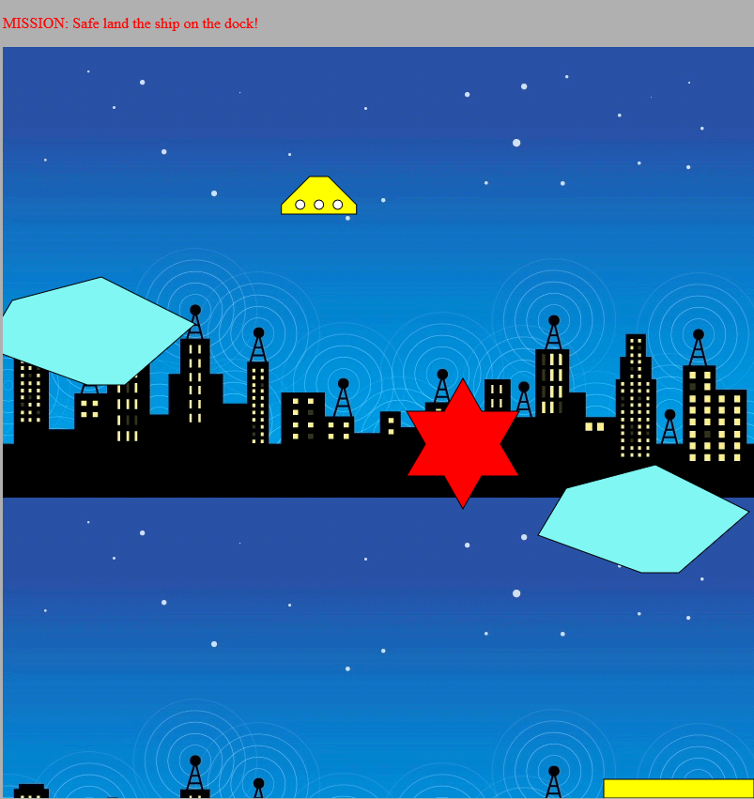
Ship-Sailing Game
Game Start
At runtime, Ship descends from the top, gradually gaining speed!
The keyboard arrow keys allows manoeuvring of the ship within the
water-way, avoiding collision with any of the barriers until able to land
safely on the dock which shares the same flashing-light effect as the
ship itself.

Slide 3
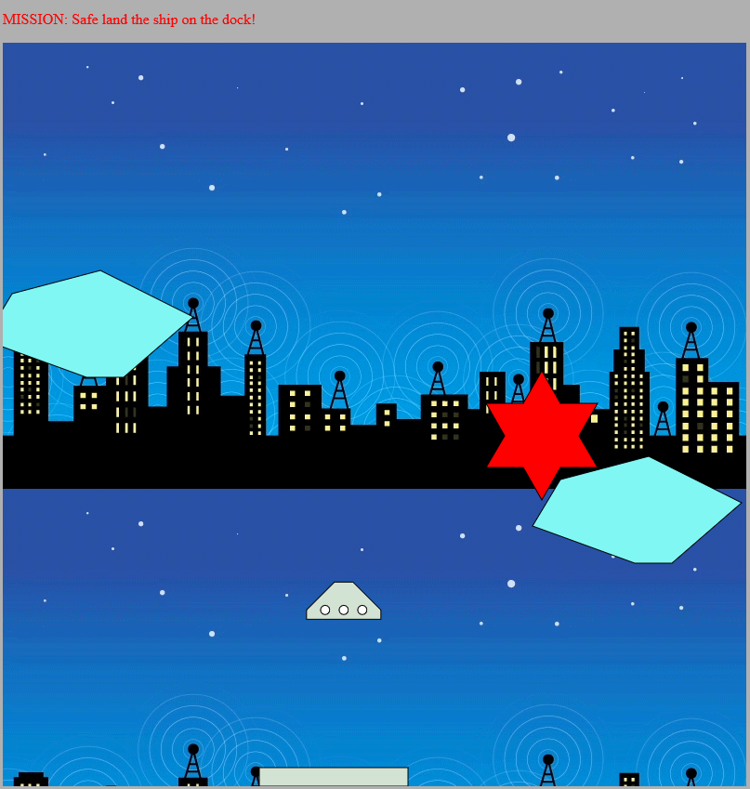
Gameplay
- The ship dock can be moved sideways to any desired position of landing,
within the X axis using the ‘Z’ and ‘X’ letters .
The speed of the ship can be managed by pressing the key to its opposite
direction.

Slide 4
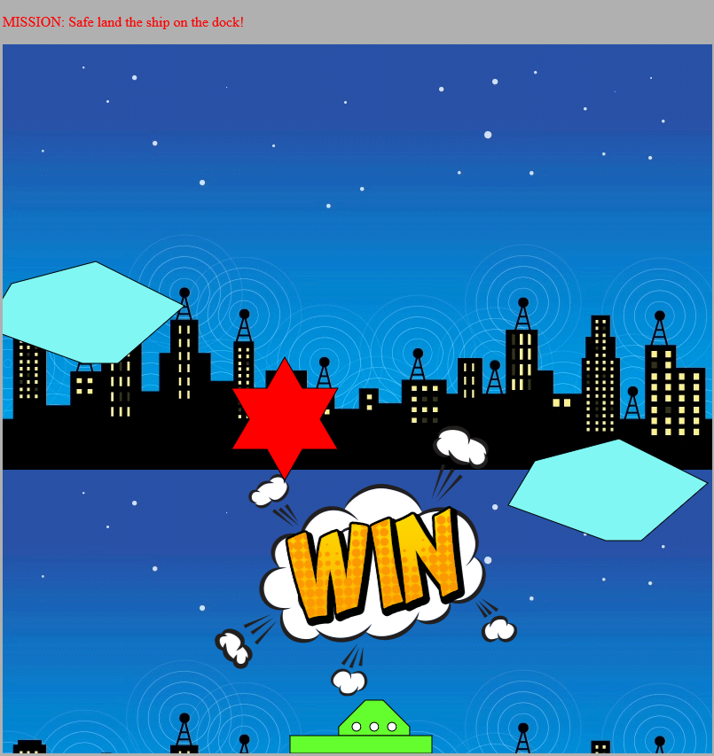
Game Success
Ship is docked successfully on the landing pad at a landing velocity of <.6. Anything above that value crashes the ship.

Slide 5
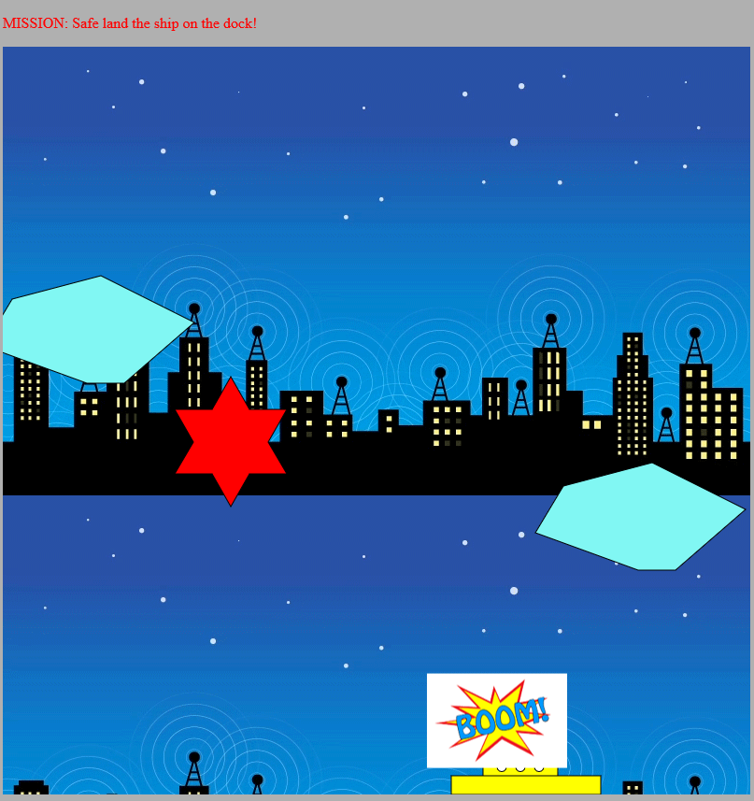
Game Failure
Ship explodes if the velocity at the time of landing is too great.

Slide 6
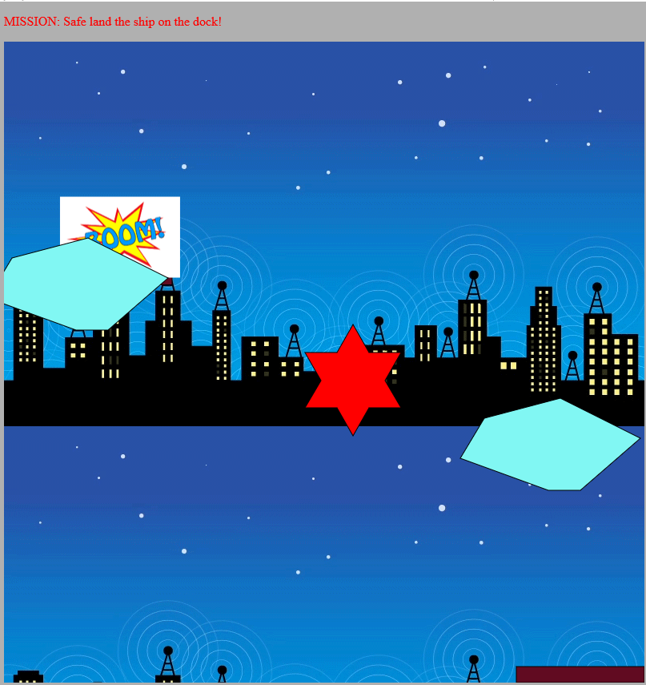
Game Failure
Ship explodes as a result of a collision with a barrier.

